Slide 1

News Popularity Intelligence System
Using Transformer-Based Deep Learning
By
S. Vanitha
February 2026

Slide 2
Problem Statement
Digital news platforms must decide which articles to highlight, promote, or deprioritize at the time of publishing. However, real-world popularity indicators such as clicks, shares, and impressions are not immediately available.
The objective of this project is to design and implement a Transformer-based News Popularity Intelligence System that:
- Learns deep semantic representations of news articles using transfer learning.
- Infers relative popularity potential directly from text.
- Ranks and scores articles based on predicted attention likelihood.
- Provides explainable insights to support editorial decision-making.

Slide 3
Core Idea
Treat popularity as a latent variable.
  - Use linguistic proxy signals.
  - Leverage Transformer semantic representation.
  - Apply weighted explainable scoring.

Slide 4
System Architecture
Layered Modular Architecture
  Data → NLP → Signals → Scoring → Ranking → Explainability → Dashboard
  - Scalable and replaceable components.

Slide 5
Data Preprocessing
Minimal text cleaning (retain semantic structure)
  - Remove URLs & HTML.
  - Combine title + description using [SEP].
  - Deduplication to prevent bias.

Slide 6
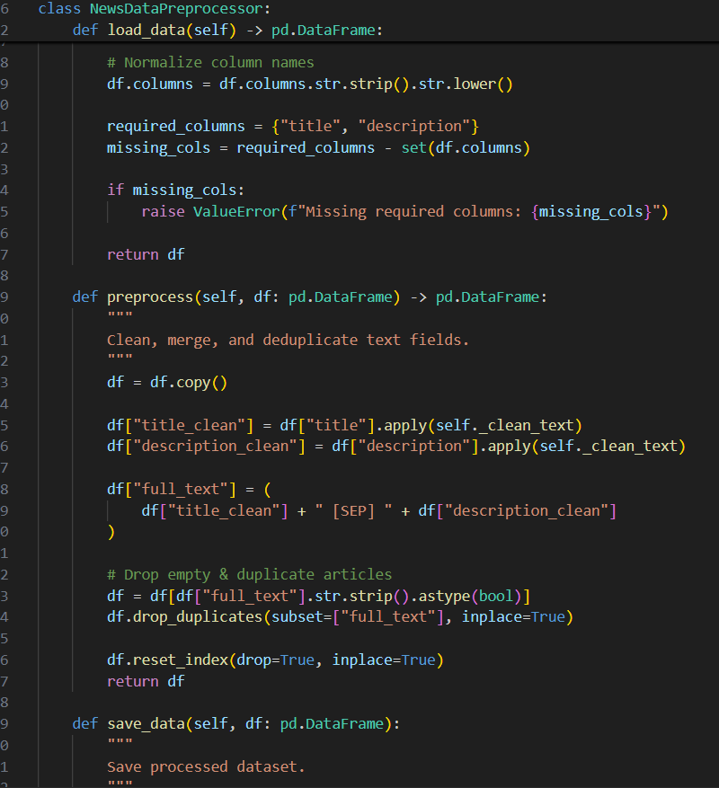
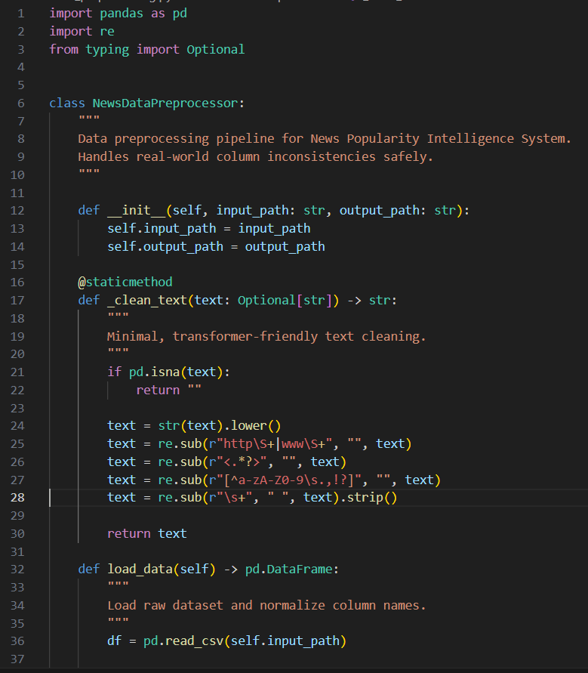
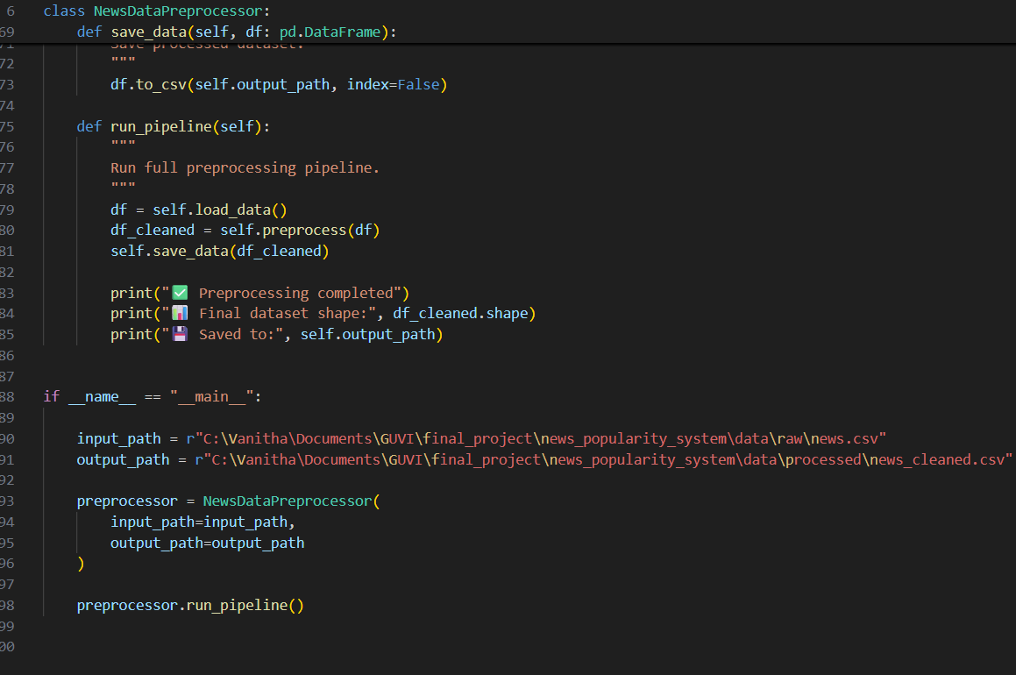

Slide 7
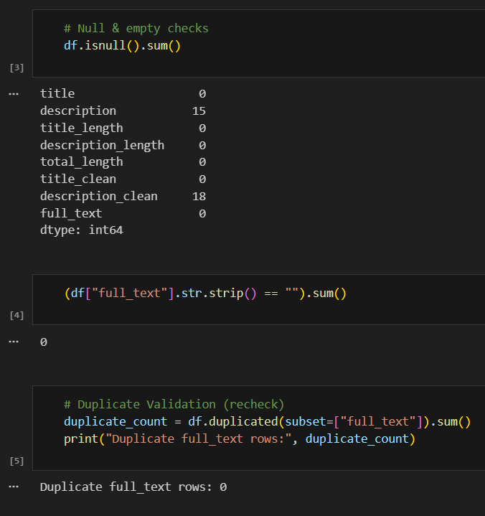
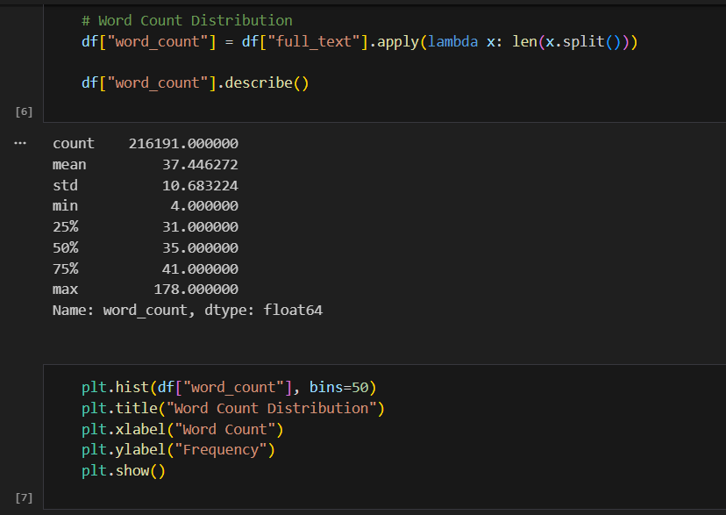
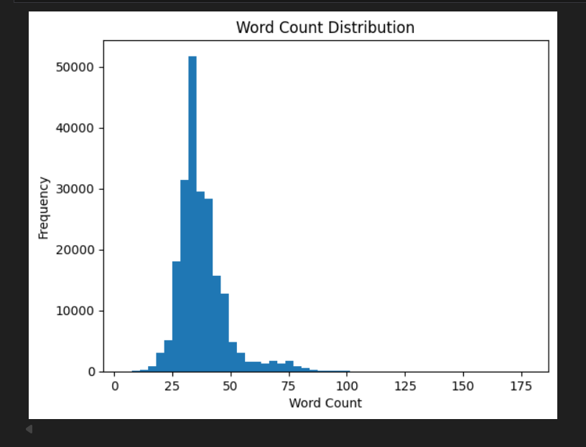
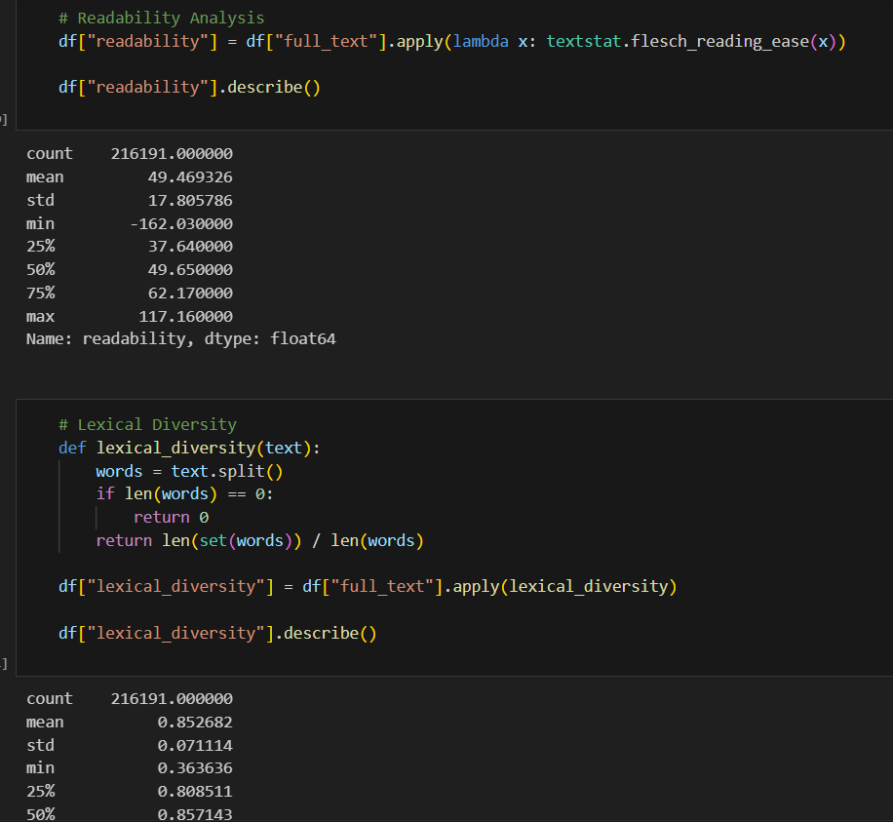
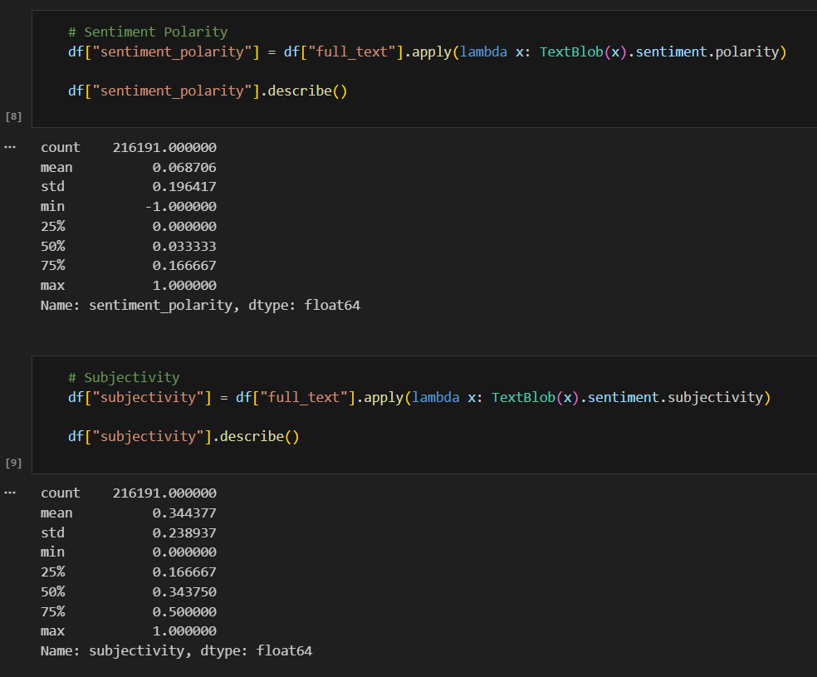
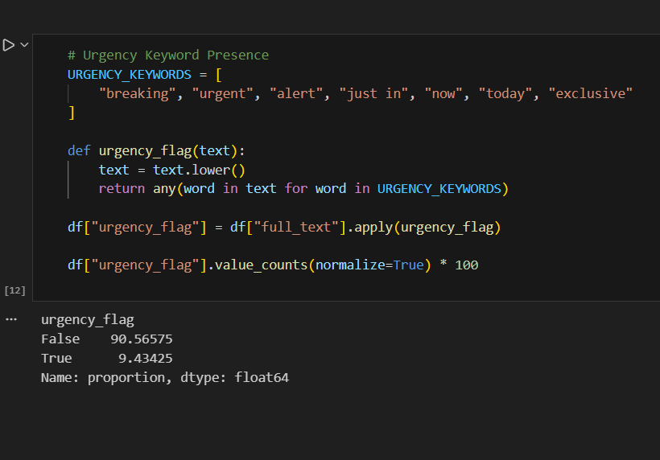

Slide 8
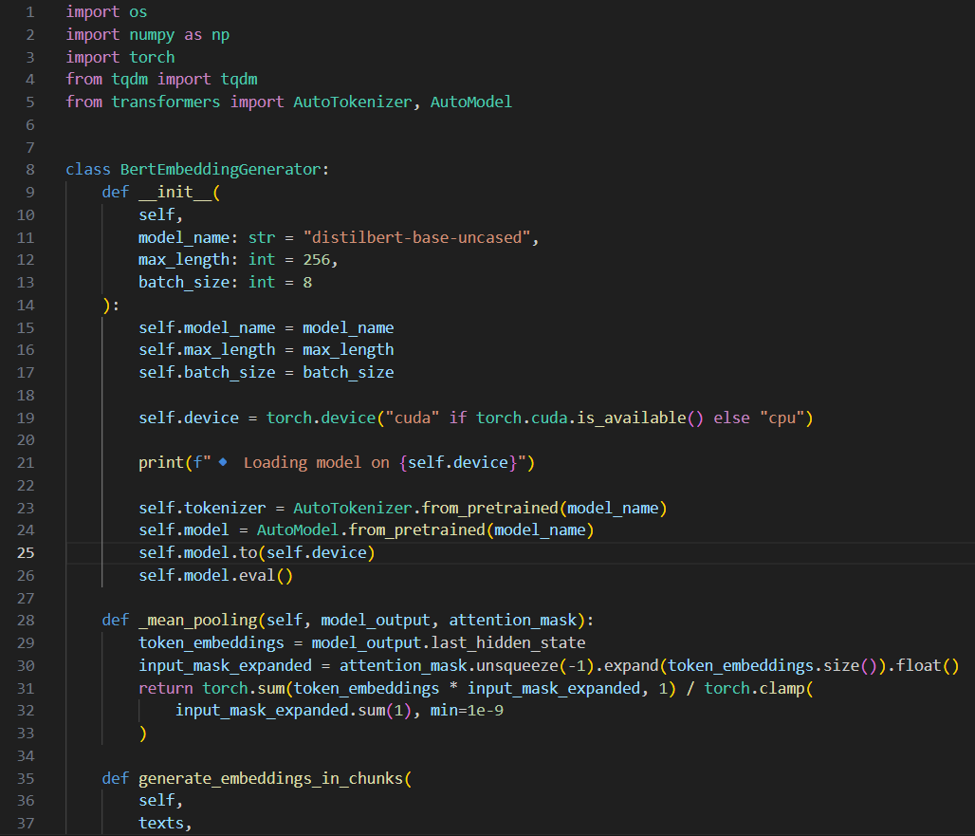
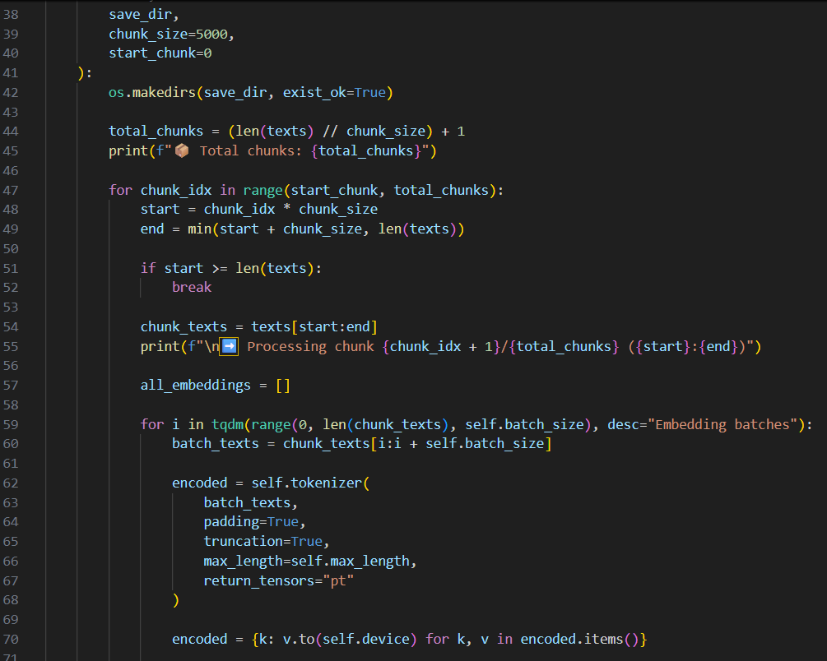
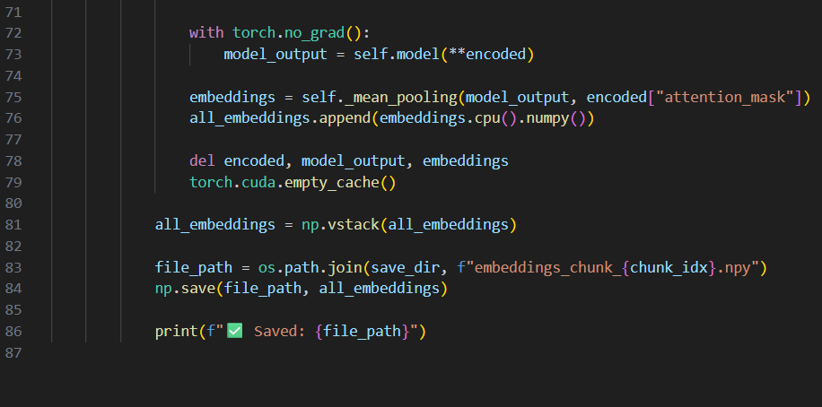
Transformer Representation
DistilBERT for contextual embeddings
  - Tokenization using pretrained tokenizer.
  - Mean Pooling for stable sentence embeddings.
  - Chunked batch processing for memory efficiency.

Slide 9
Why DistilBERT?
Lightweight and faster than BERT
  - Lower memory consumption.
  - Retains ~97% performance of BERT.
  - Suitable for production deployment.

Slide 10
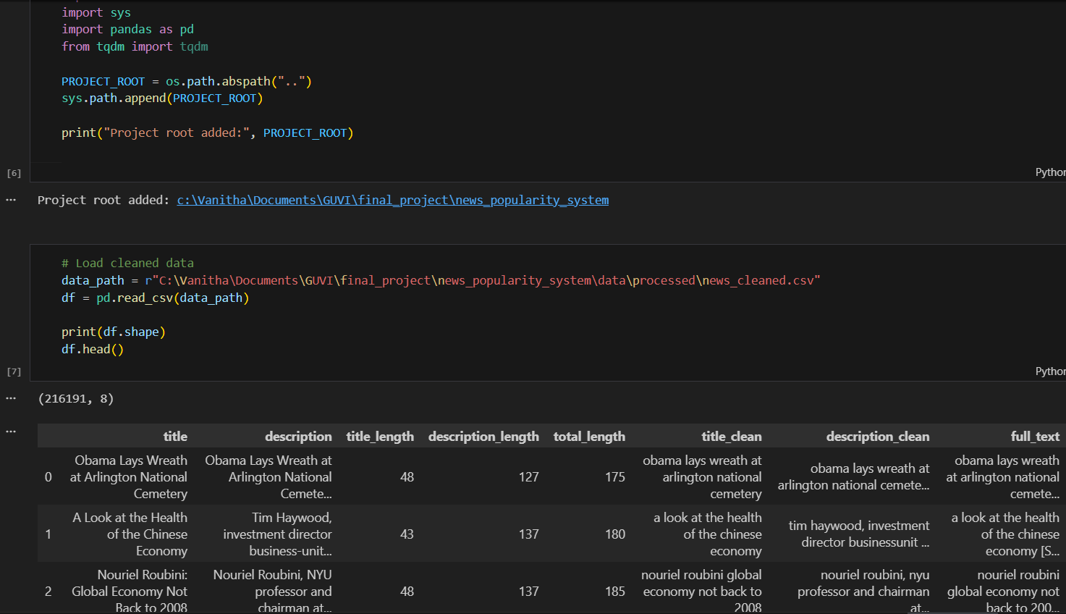
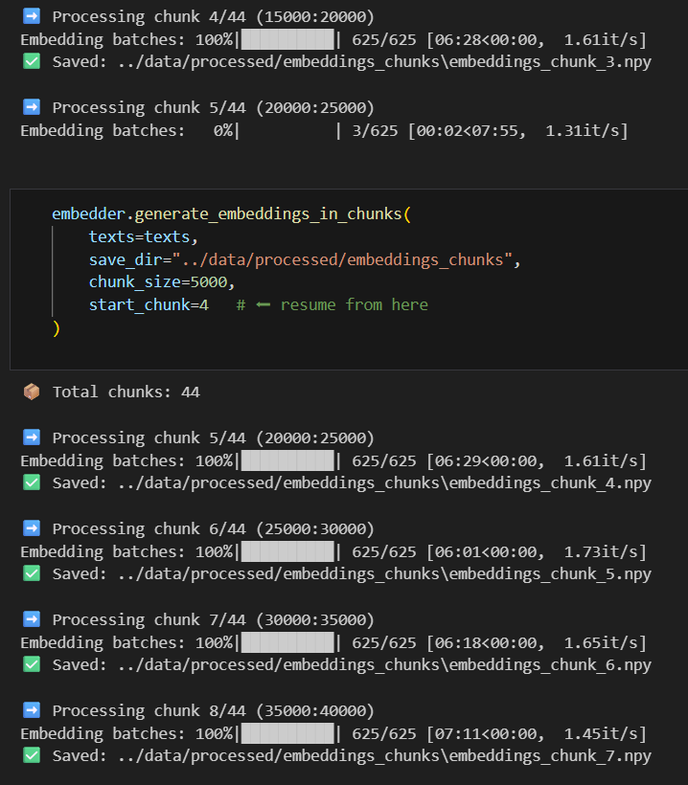
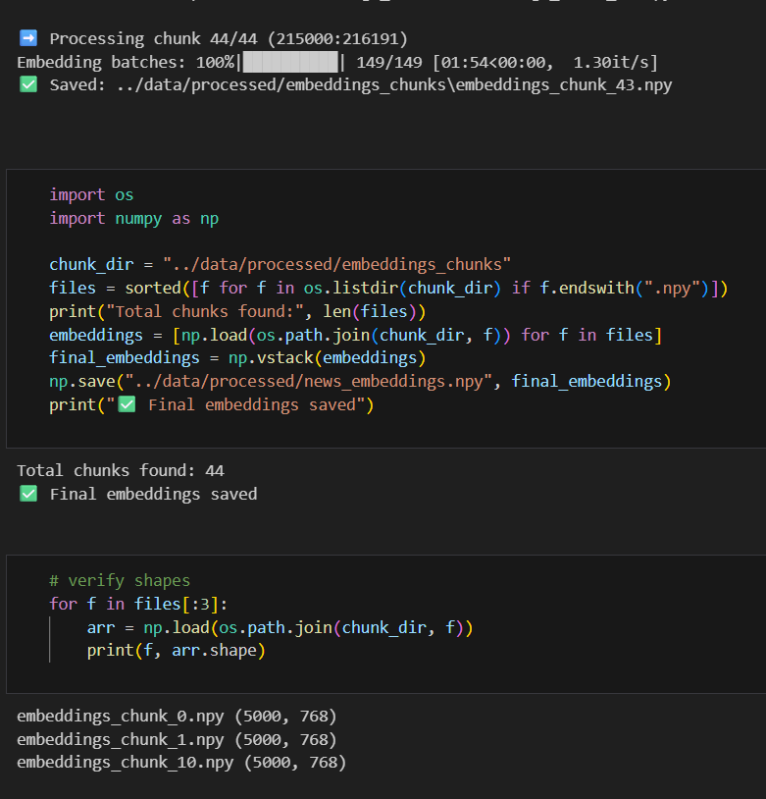
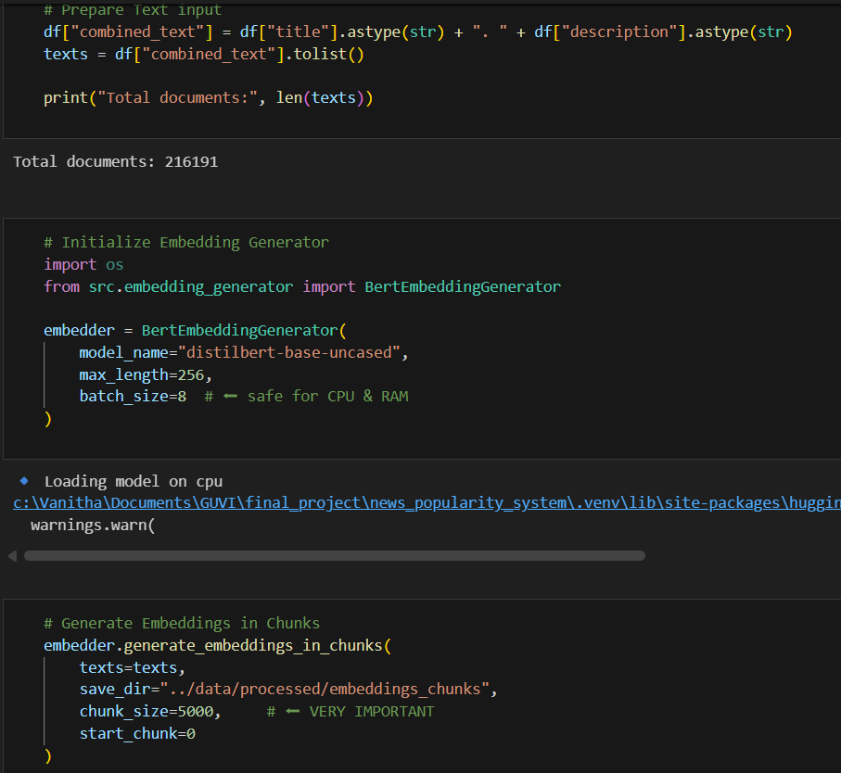

Slide 11
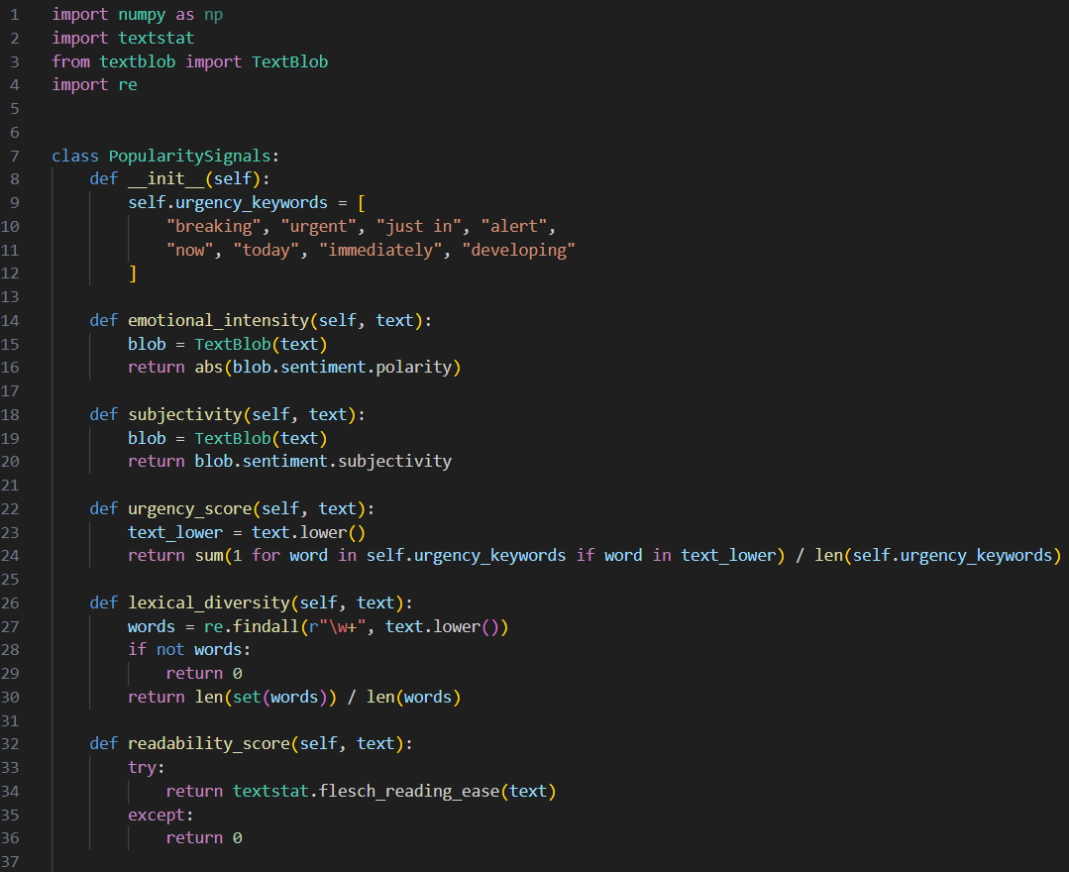
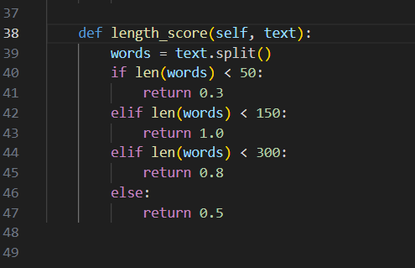
Proxy Signal Engineering
Emotional Intensity
  - Urgency Detection
  - Lexical Diversity
  - Readability Score
  - Subjectivity Score
  - Length Optimization Signal

Slide 12
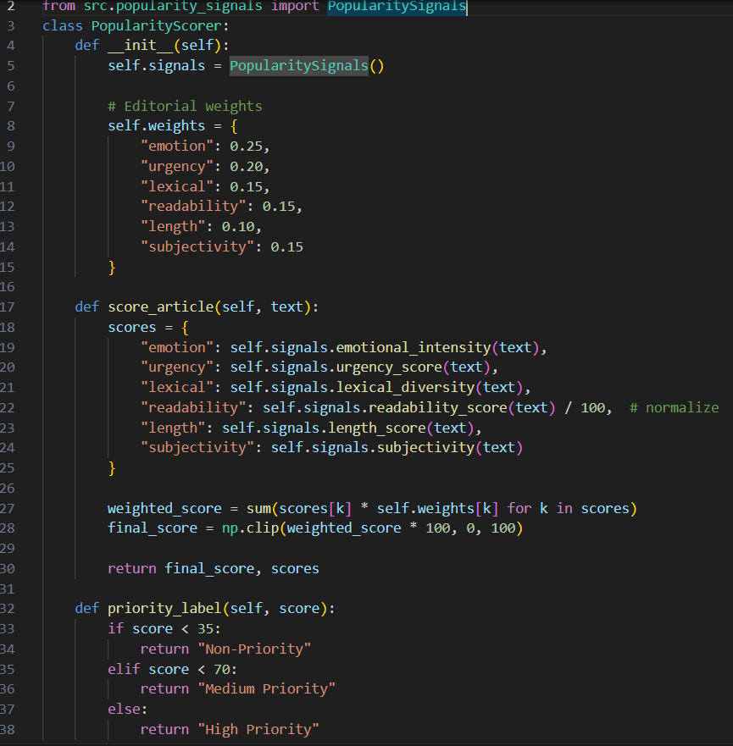
Weighted Scoring Framework
Emotion (0.25)
  - Urgency (0.20)
  - Lexical Diversity (0.15)
  - Readability (0.15)
  - Subjectivity (0.15)
  - Length (0.10)
  - Normalized Final Score (0–100%)

Slide 13
Why Weighted Instead of ML?
No labeled popularity data available
  - Interpretability required for editorial trust.
  - Business-adjustable weight tuning.
  - Transparent and explainable modeling.

Slide 14
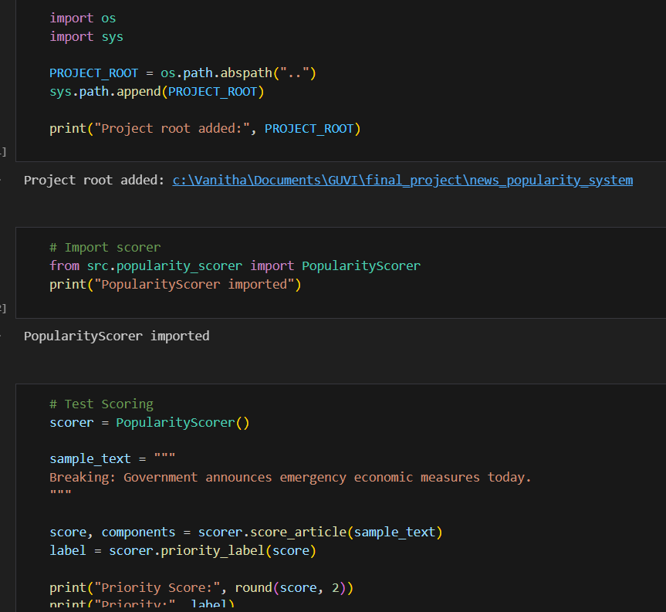
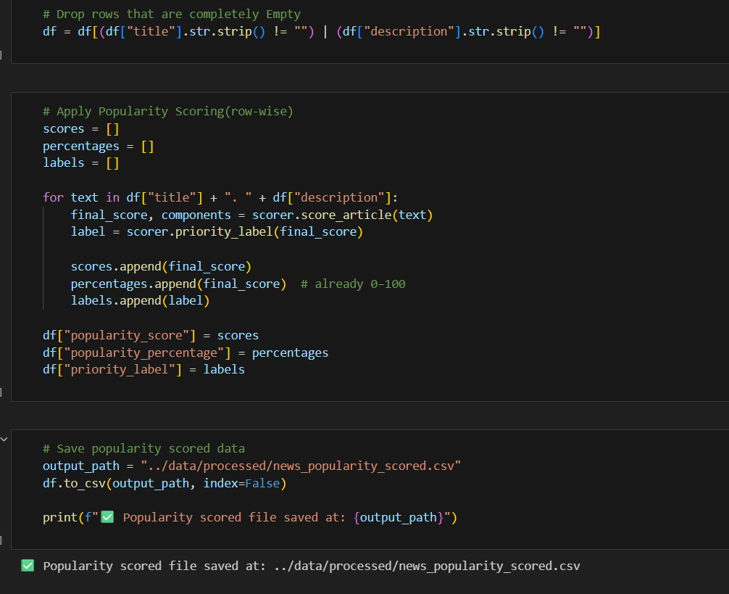
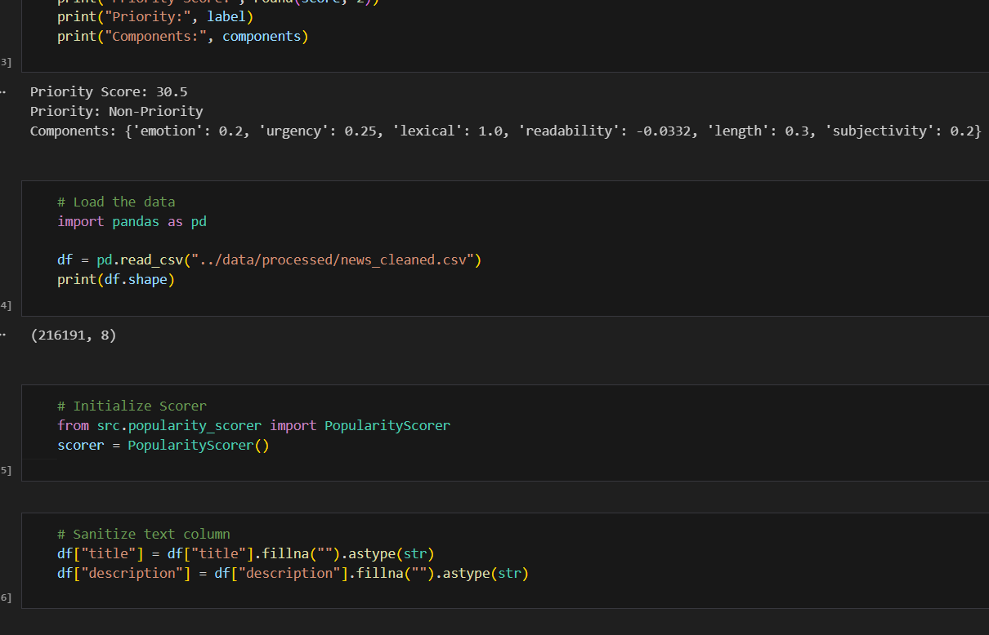

Slide 15
Priority Classification & Ranking
High / Medium / Non-Priority categorization
  - Global ranking by popularity score.
  - Priority-aware ranking for editorial workflow.

Slide 16
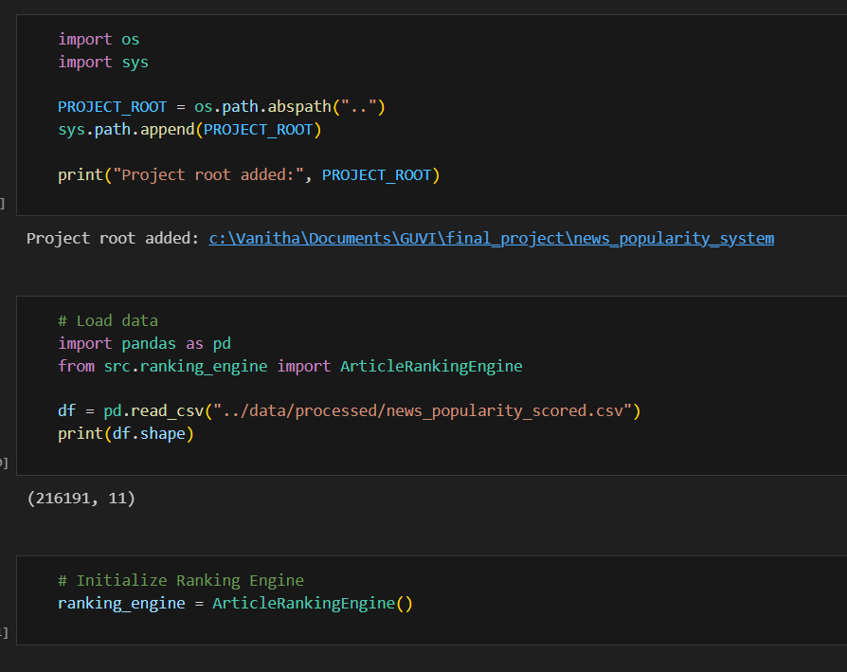
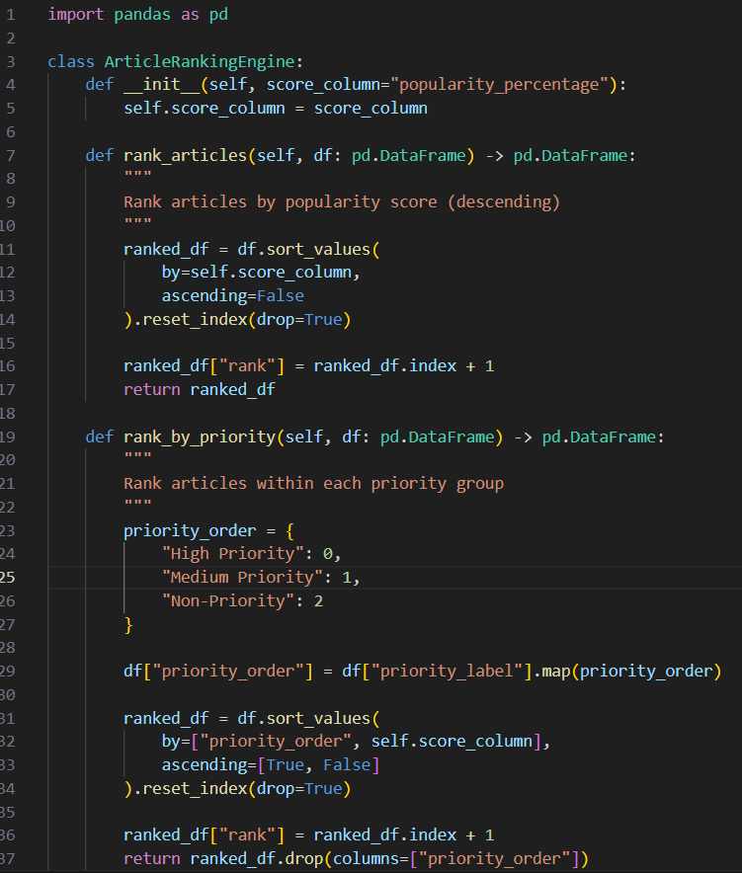
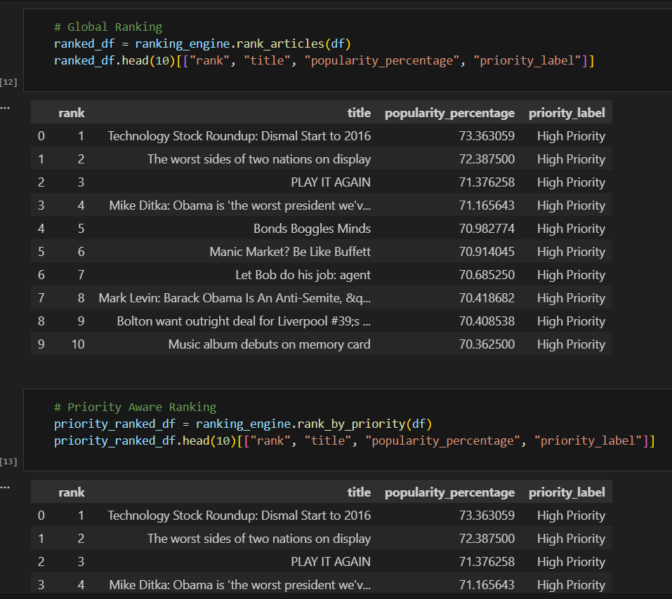

Slide 17
Explainability Engine
Contribution = Signal Score × Weight × 100
  - Top contributing factors extraction
  - Avoids black-box AI decisions
  - Improves decision transparency

Slide 18
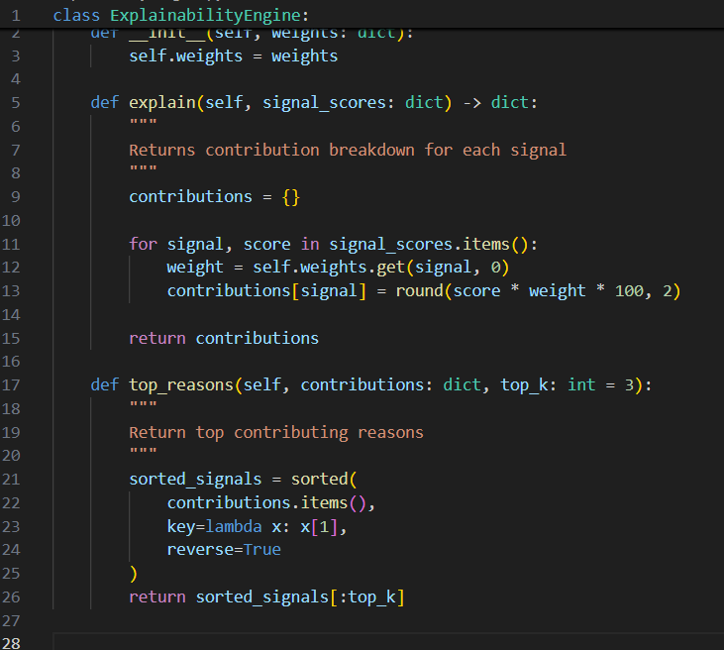
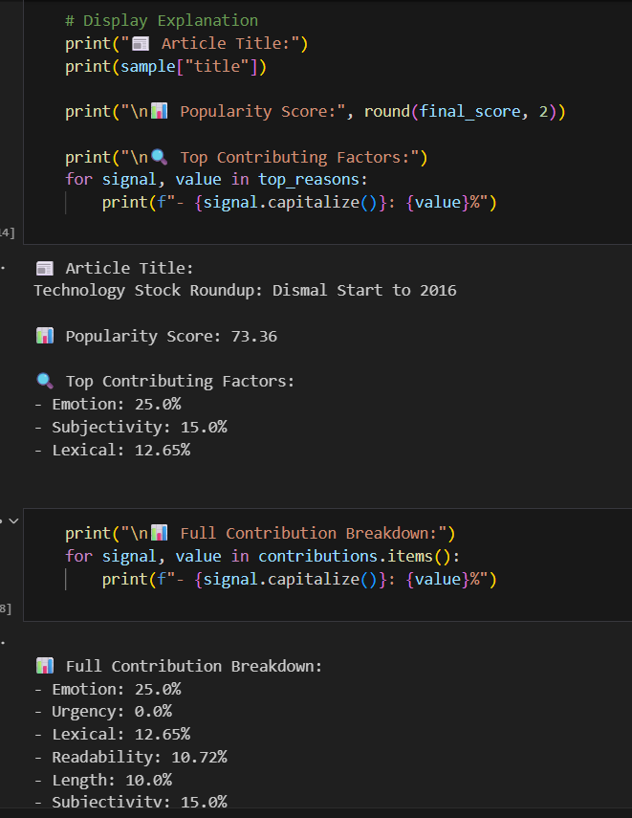
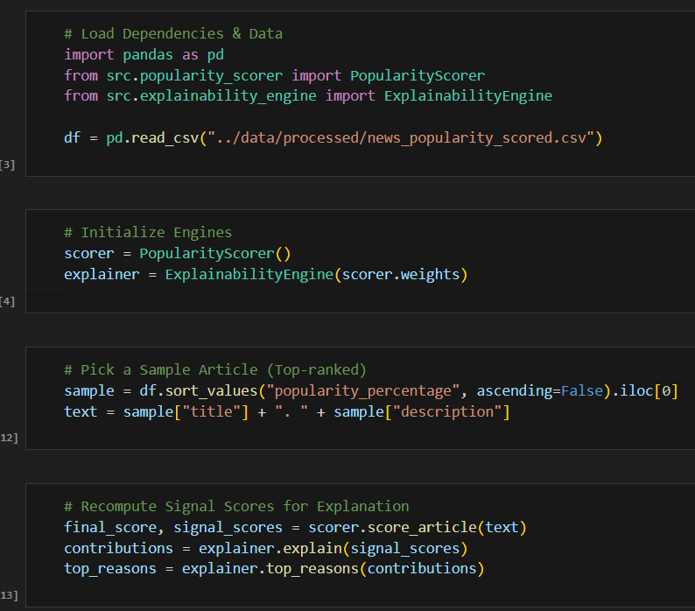

Slide 19
Dashboard Deployment (Streamlit)
Real-time article scoring
  - Priority label output
  - Contribution visualization
  - Architecture overview display

Slide 20
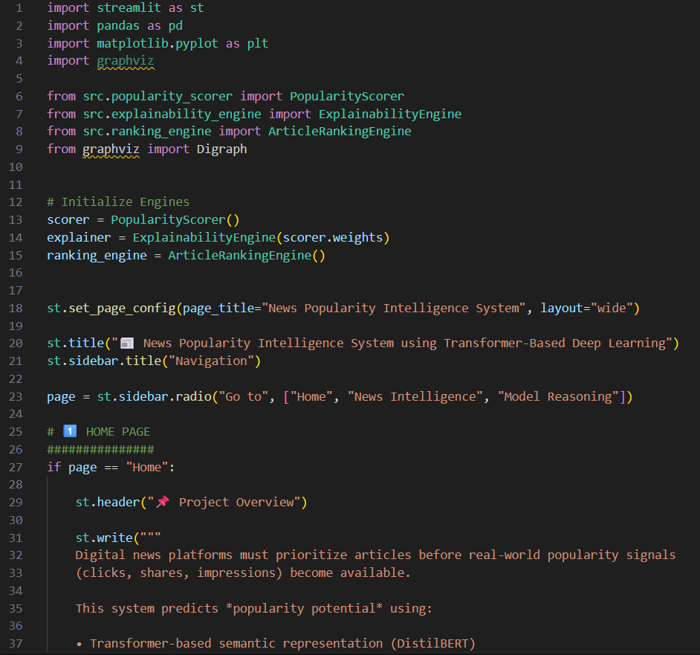
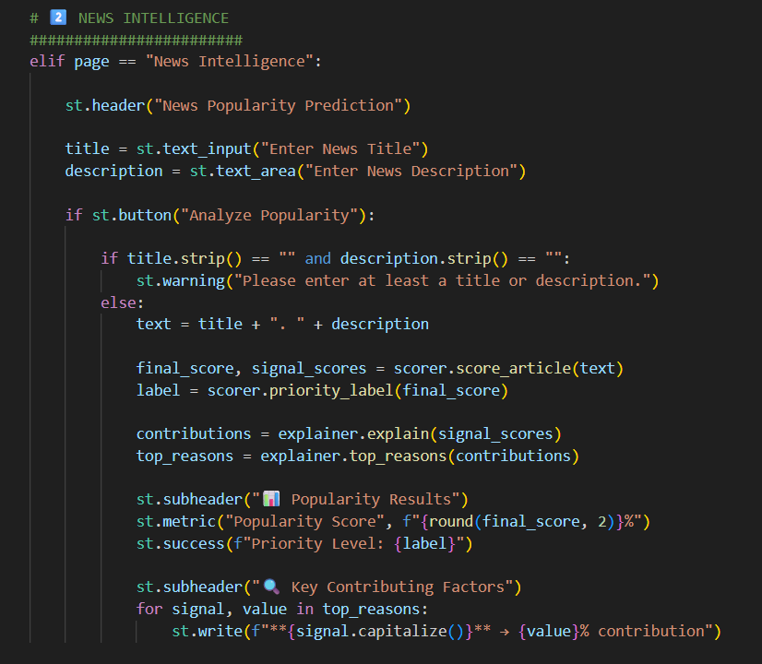
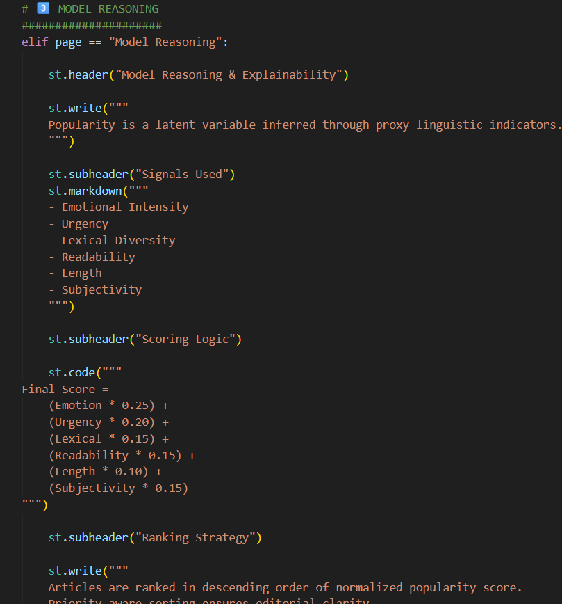
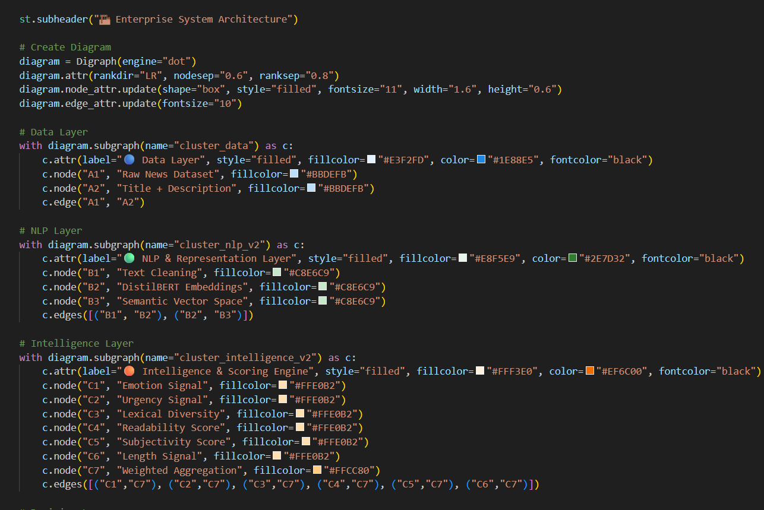
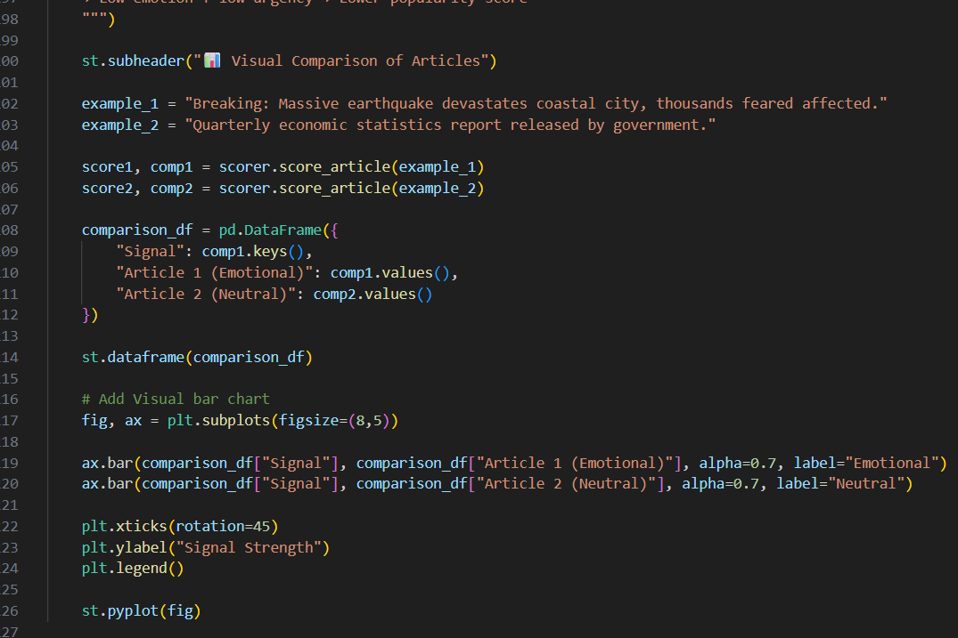

Slide 21
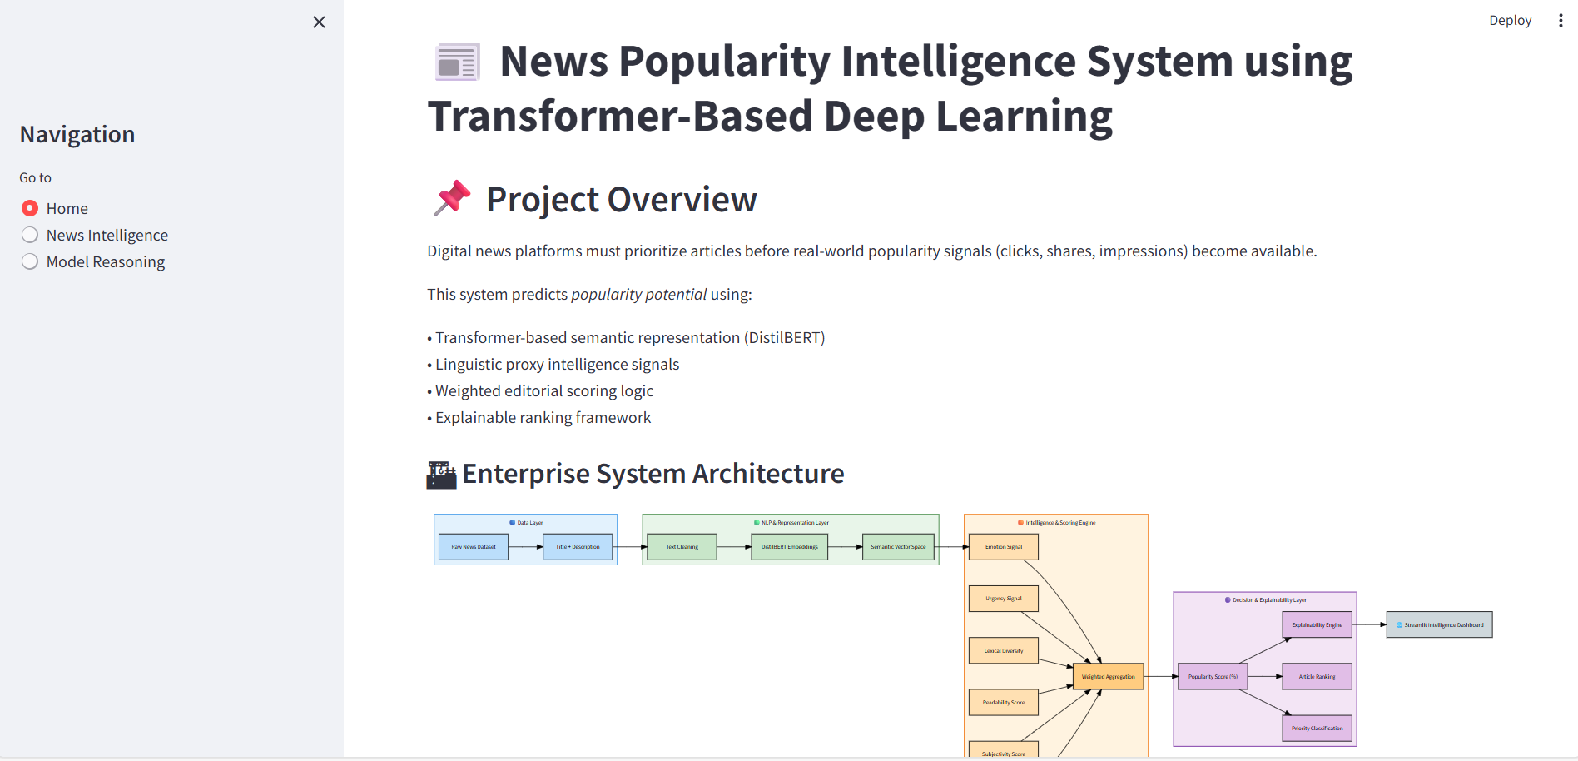
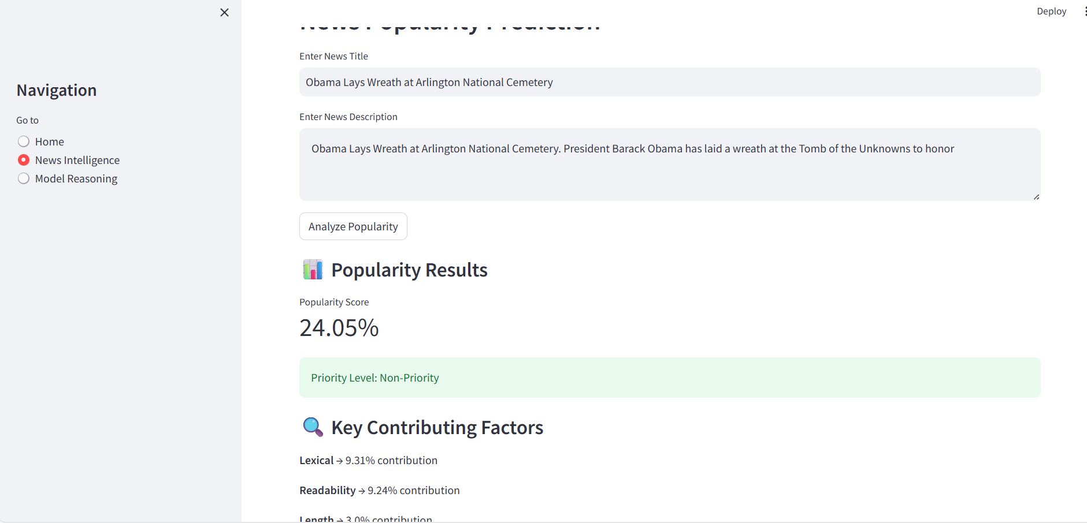
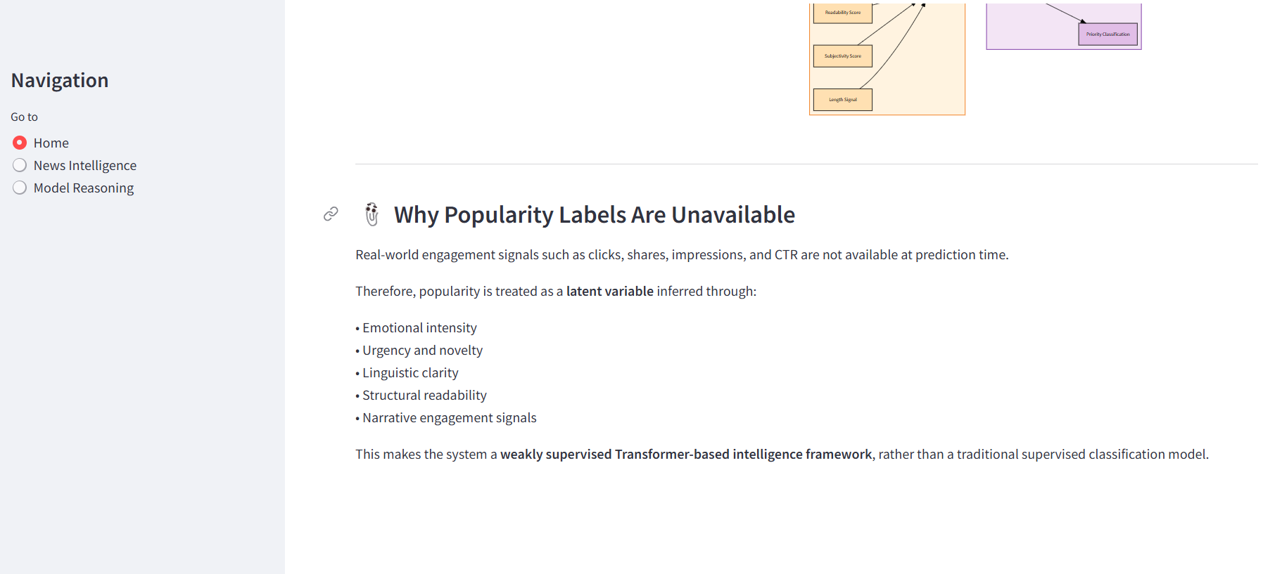

Slide 22
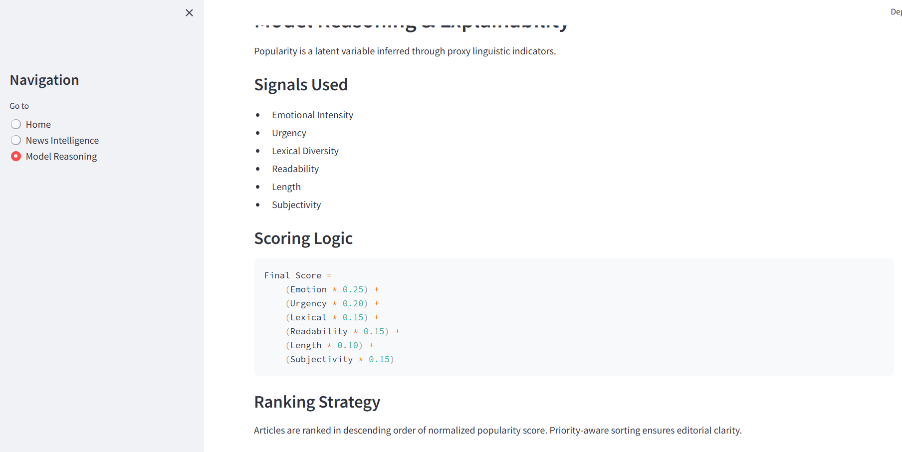
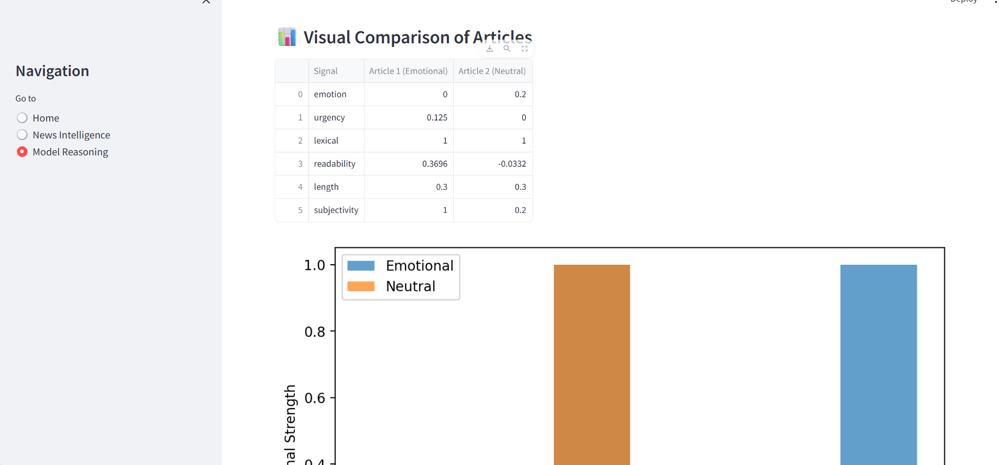

Slide 23
Limitation
Heuristic weight assignment
  - No real engagement label validation.
  - No personalization layer.
  - Cultural bias possible in sentiment detection.

Slide 24
Future Enhancements
Reinforcement learning for weight optimization
- Fine-tuned Transformer model for engagement prediction.
- Reinforcement learning for weight optimization.
- Real-time API deployment.
- A/B testing integration.
- User personalization layer.
- Automated weight learning via weak supervision.

Slide 25
Industry Applications
Digital News Platforms
  - Content Recommendation Systems.
  - Editorial Decision Support.
  - Media Intelligence & Analytics Platforms.

Slide 26
Conclusion
Transformer-based semantic intelligence
  - Weakly supervised proxy modelling.
  - Explainable AI scoring framework.
  - Deployable modular system.

Slide 27
Thank You

